Slide 1
Novel Control Methods for California Prionus beetles using entomopathogenic nematodes
Justin Clements
8-3-2021

Slide 2
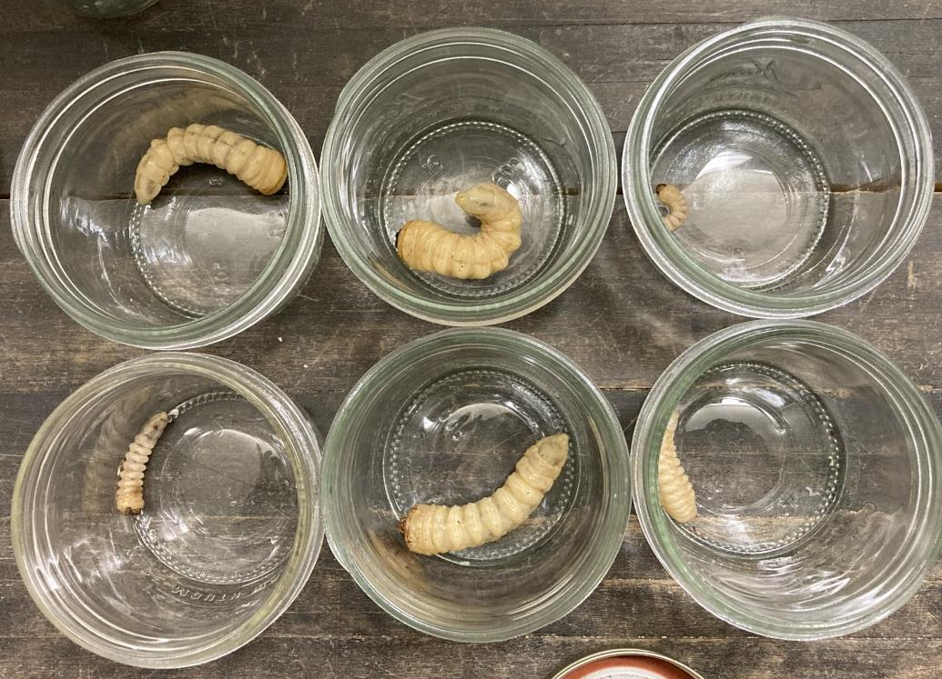
Outline
EPN control of CPB
  California prionus beetle (CPB)
  Entomopathogenic nematodes (EPNs)
  Objectives and progress
Parma Research Plot
Idaho USDA Variety Plot

Slide 3
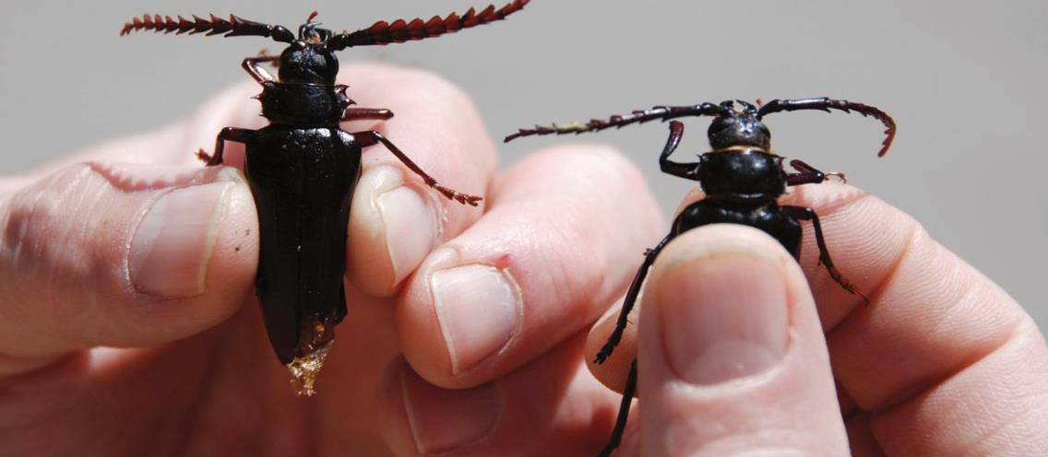
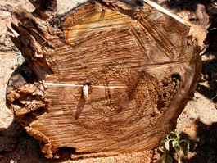
California Prionus beetle (Prionus californicus)
Native insect species to the western United states
  Range from Mexico to Alaska
  Sporadically located throughout the Pacific Northwest
Can feed on 21 different plant species
  Hops, grapes, orchard trees (cherries) and more
Included in the longhorn beetle family (Cerambycidae)
  More than 25 different closely related Prionus species can be found throughout North America, Europe, and Asia
Life span is approximately 3-5 years
  Adults only present for 2-3 weeks
  A mated adult female can lay between 150-200 eggs during her 21-day life span
Image by J.D. Barbour
Image by S. Steffan

Slide 4
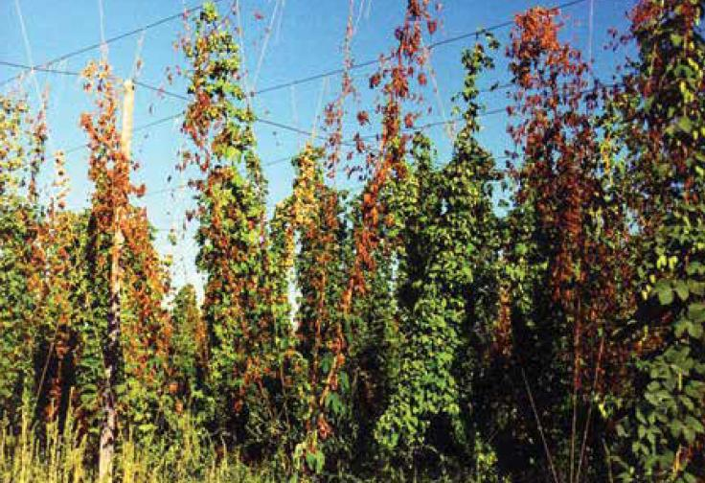
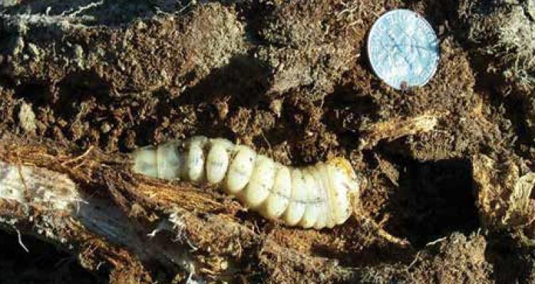
California Prionus beetle
Damage is the result from larval feeding within the plant root system over multiple years
  Decreased nutrient uptake
  Water stress
  Reduced plant growth
Above ground symptoms include:
  Plant wilting
  Yellowing
  Death of bines or the entire plant
Damage can also result from the introduction of fungal and bacterial pathogens
Images by J.D. Barbour

Slide 5

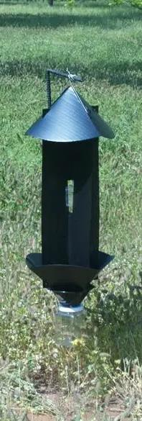
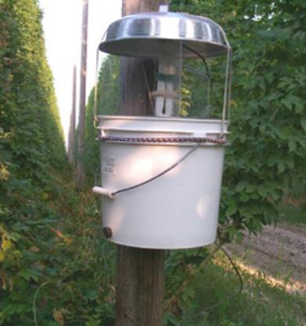
California Prionus beetle
Current management/monitoring of pest populations
Pre-planting fumigants
Mocap EC (90 day preharvest interval)
Removing and destroying infected fields
Trapping adult beetles during nightly flights
  Light traps
  Pheromone baited traps to lure male insects have proven highly effective.
    Do not target pest stage of insect
    Not registered for pest control
Image by J.D Barbour

Slide 6
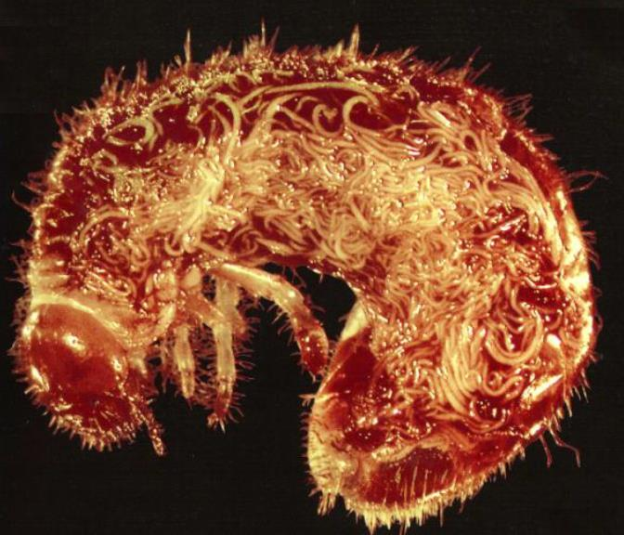
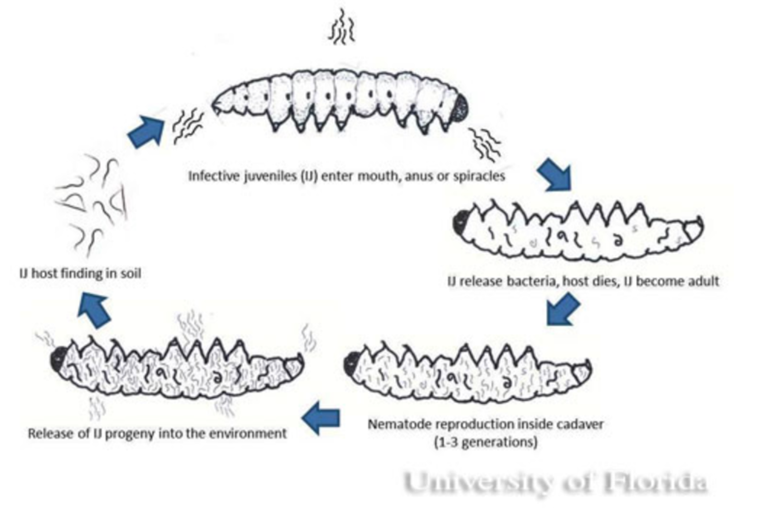
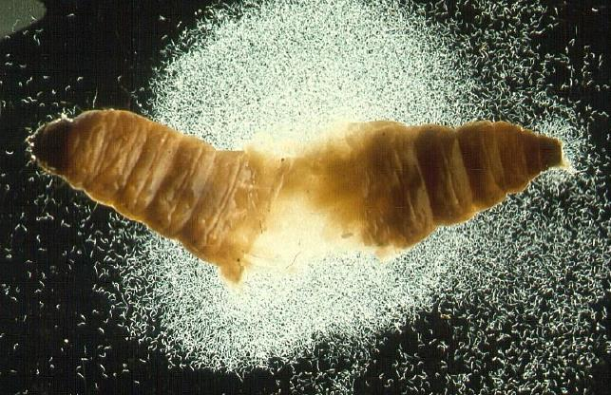
Entomopathogenic nematodes
  Insect specific parasites which predate and reproduce in insect hosts
    Causes insect death from septicemia caused by bacterial mutual associate with EPNs
Images by R. Gaugler

Slide 7
EPN CONTROL OF cpb
Proposed research
1) Determine optimal EPN species for CPB control by laboratory and greenhouse assays
2) Conduct field trials with optimized EPN species and application methods at Gooding Farms
3) Develop extension bulletins and guidelines for growers for the use of EPNs to control CPB larvae and other soil dwelling pests of hops

Slide 8
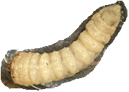
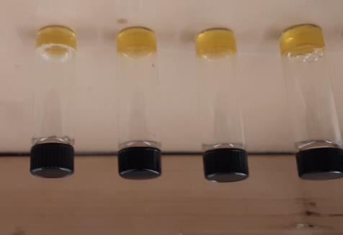
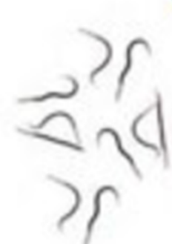


























Winter/Spring 2021
California prionus beetle larvae were collected from one of Gooding Farms’ fields (November 2020)
Larvae were given to Dr. Lewis and Dr. Stevens for EPN screening
Beetles were screened against
  Heterorhabditis bacteriophora, +/- EPN Pheromone, different rate of infective juvenal (IJ)
  Steinernema riobrave +/- Pheromone, different rate of infective juvenal (IJ)
  Steinernema glaseri +/- Pheromone, different rate of infective juvenal (IJ)

Slide 9
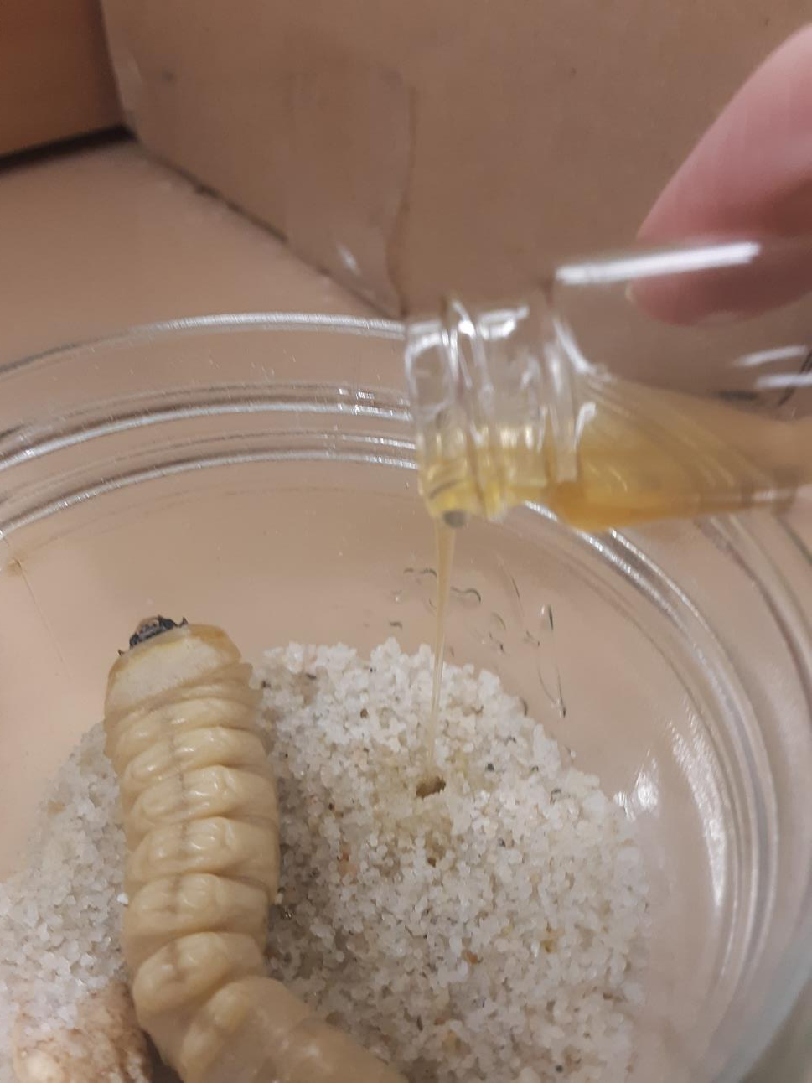

Winter/Spring 2021
California prionus beetle larvae were collected from one of Gooding Farms’ fields (November 2020)
Larvae were given to Dr. Lewis and Dr. Stevens for EPN screening
Beetles were screened against
  Heterorhabditis bacteriophora, +/- EPN Pheromone, different rate of infective juvenal (IJ)
  Steinernema riobrave +/- Pheromone, different rate of infective juvenal (IJ)
  Steinernema glaseri +/- Pheromone, different rate of infective juvenal (IJ)
X
X

Slide 10
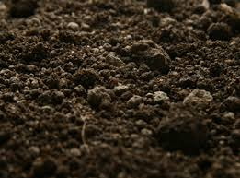
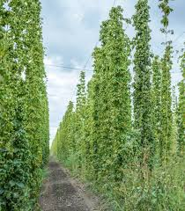
Summer 2021 studies
Group meeting between Clements Lab and Lewis Lab was held at Parma Research Station on May 5th , 2021 to outline studies and objectives
Objective 1: Set out 40 bucket pitfall traps
Objective 2: Collect CPB on MWF each week from June until early August, noting population density.
Objective 3: Collect eggs from mated females
Objective 4: Hatch eggs and send Larvae to Glen Stevens for more EPN analysis
  Steinernema glaseri at 3,000 IJ +/- Pheromone, +/- Aza direct
  2 more species of EPNs
Dig for larvae in fall 2021 if we are unable to get the needed number of CPM for testing (50-100)

Slide 11
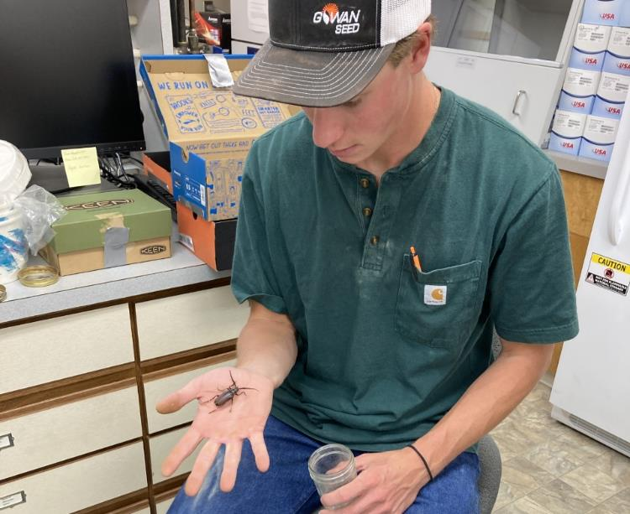
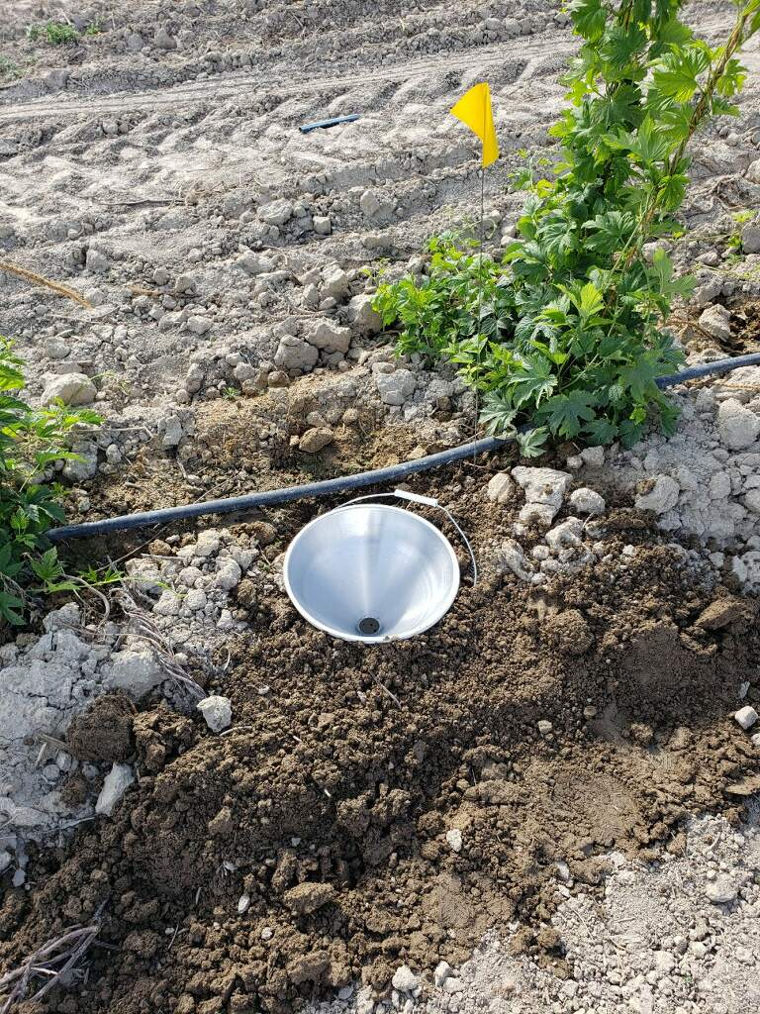
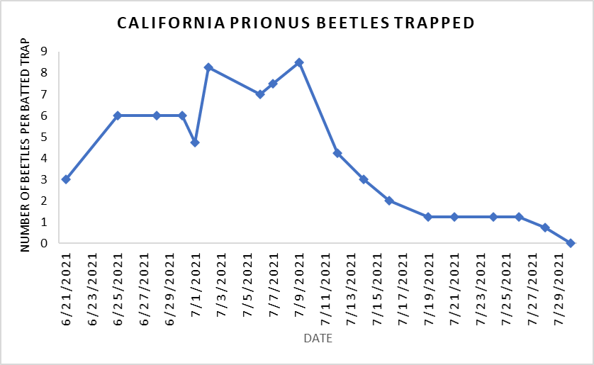
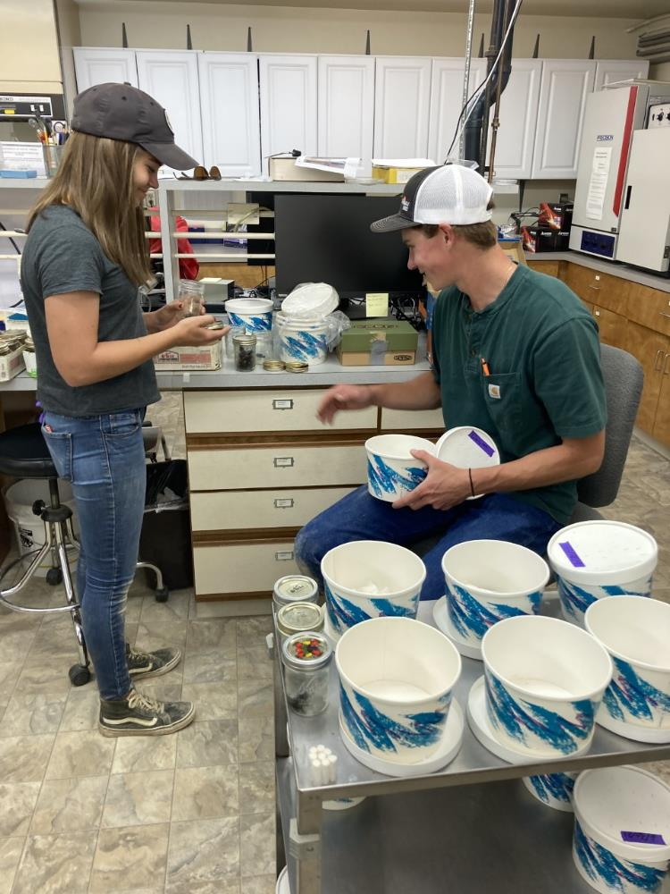
Summer 2021 studies
Environmental Requirements
225 beetles were collected and sexed
3 females were collected
Peak abundance was ~7/5/2021

Slide 12
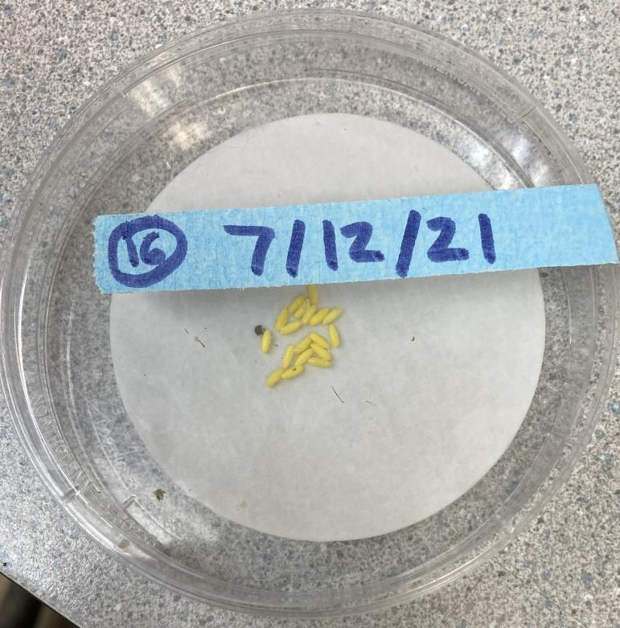
Summer 2021 studies
Environmental Requirements
3 females were collected
Females laid ~30 eggs
Placed on hop roots in greenhouse
Fall we will dig again for more beetles

Slide 13
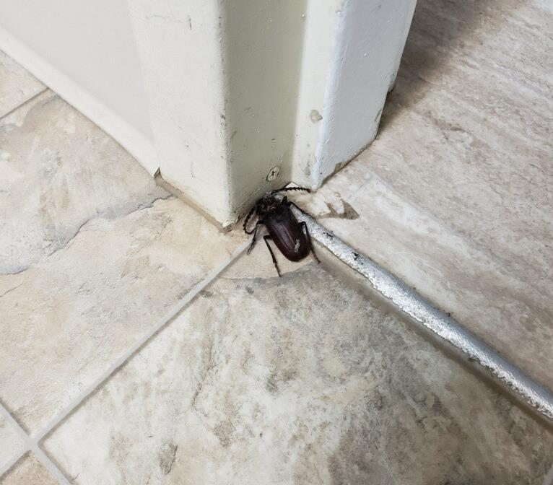
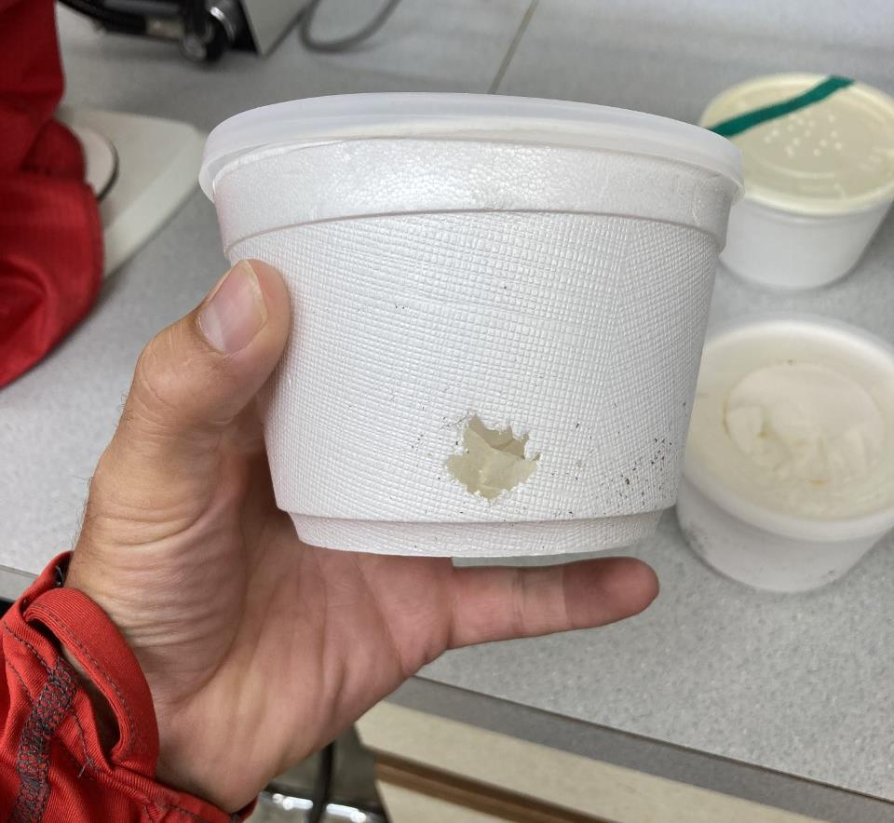
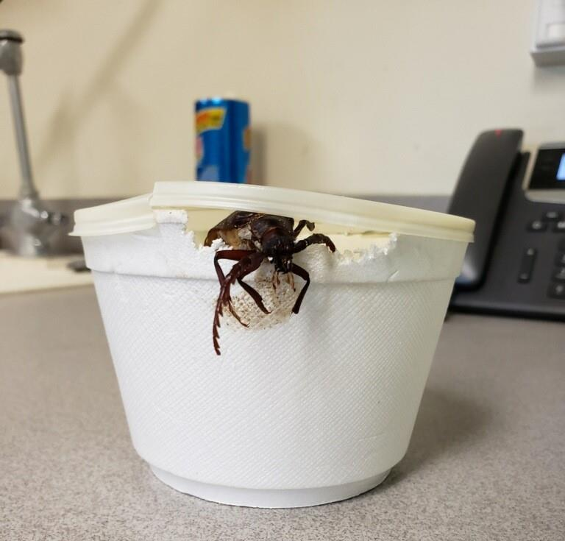
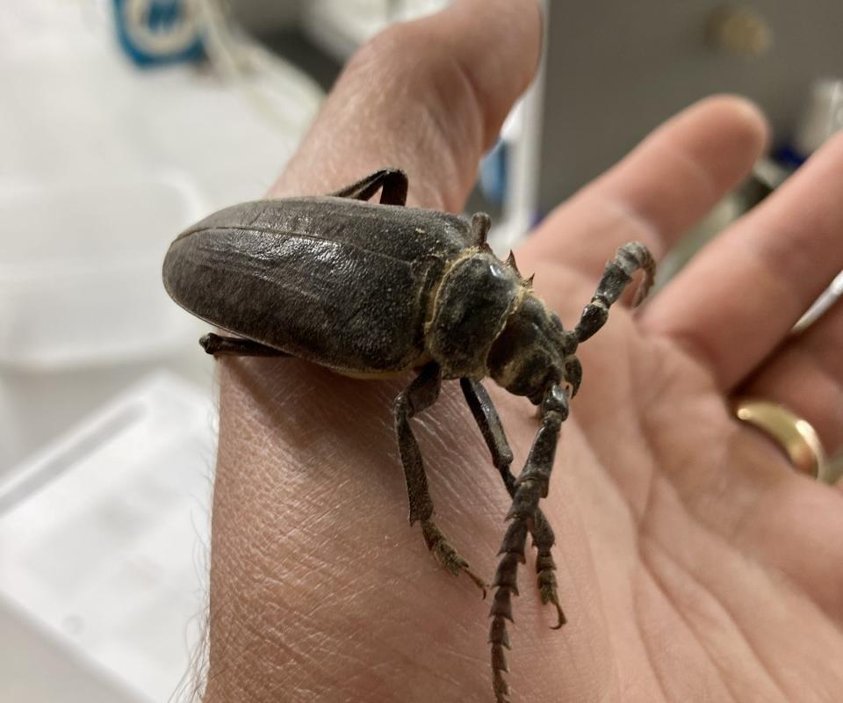
Summer 2021 studies
They got out!!!!!

Slide 14
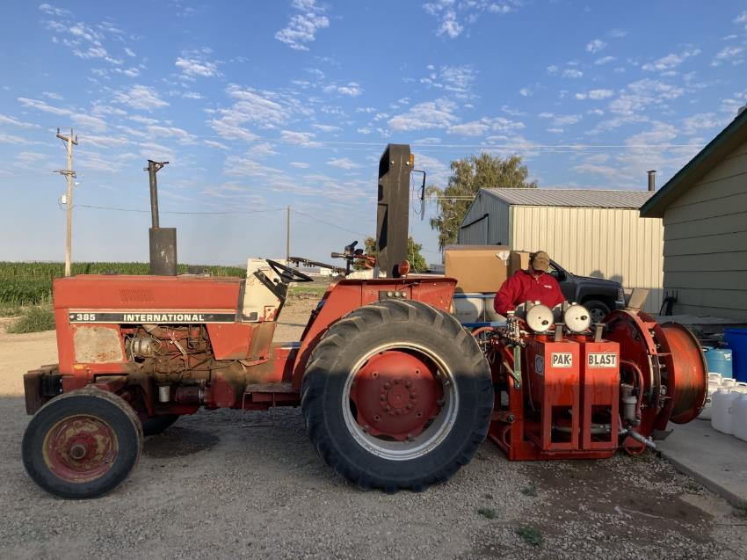
Summer 2021 FIELD TRIALS
GOWAN – TSSM (Foliar)
JMC – TSSM and Powder and Downy Mildew (Foliar)
IR4 – William Meeks

Slide 15
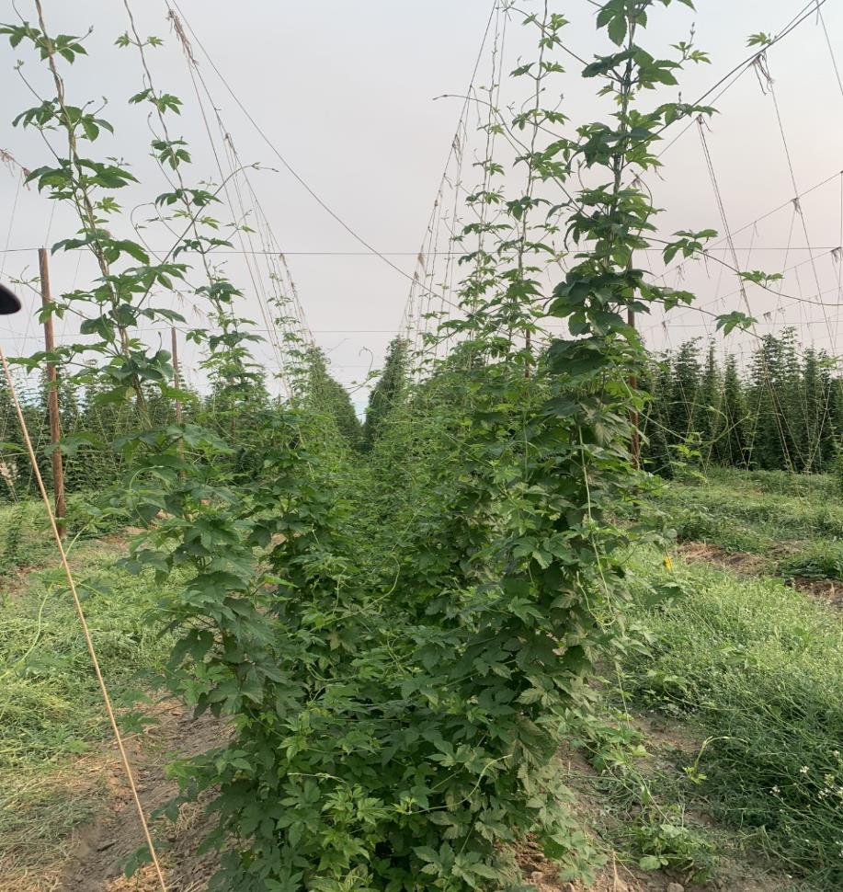
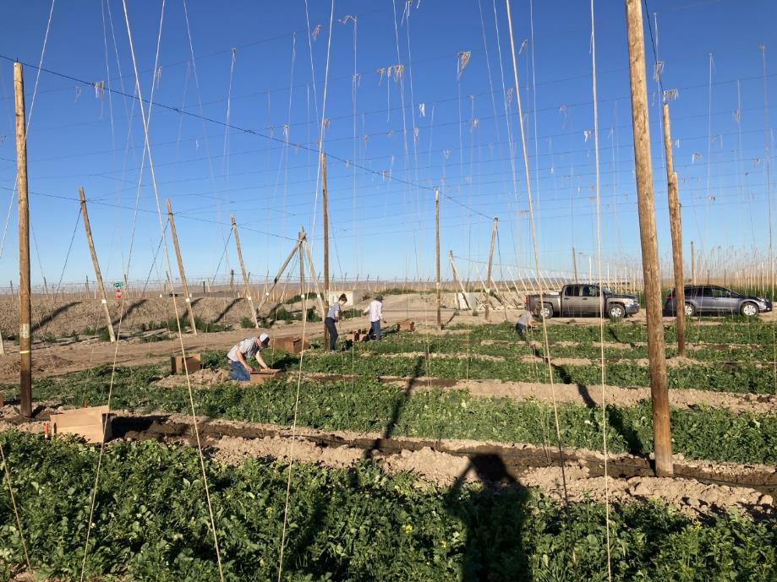
USDA Idaho Variety plot
Dr. Altendorf and Dr. Henning determined appropriate lines for Idaho
Dr. Altendorf and Anna Tawil propagated lines
Idaho group planted lines 6/2/2021
Maggie Haylett has been monitoring lines weekly
Harvest two lines this year from old plot

Slide 16

Acknowledgements
California prionus beetle project
Edwin Lewis, PhD
Glen Stevens, PhD
Gooding Farms
Maggie Haylett
Brenda Nelson
Silas Shumate
Nicole Young
USDA Idaho Variety Plot
Kayla Altendorf
John Henning
Anna Tawil
Judy Thoet
Idaho Hop Commission
General hops help
Doug Walsh, PhD
Funding
University of Idaho startup funds
Hops Research Council

Slide 17
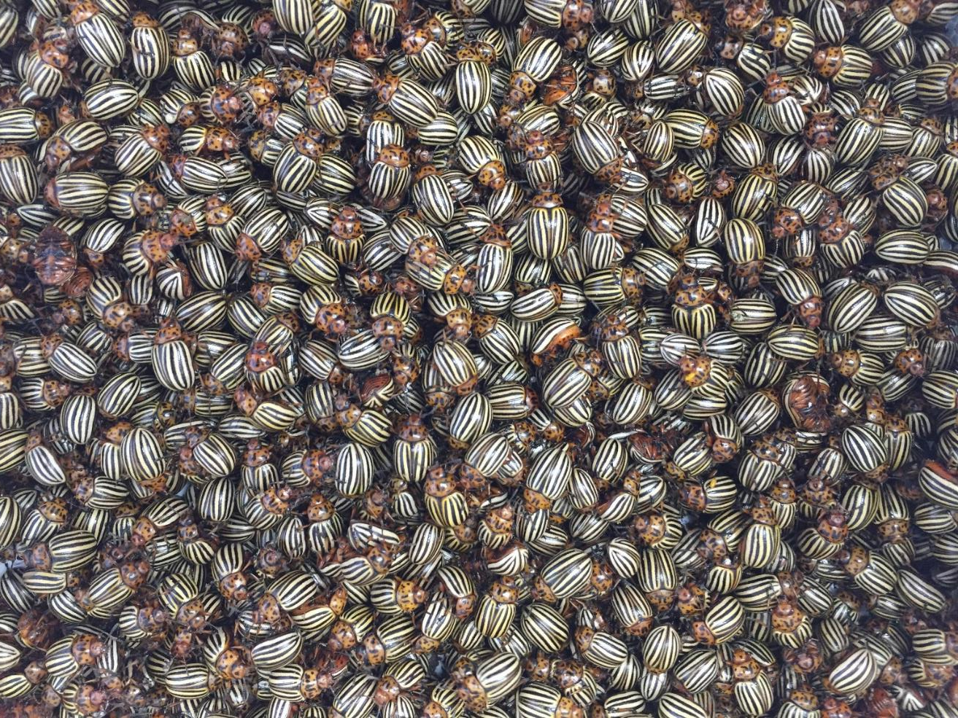
Questions?
Email: justinclements@uidaho.edu

