Slide 1
Alternative Methods for Viroid Elimination in Hops

Slide 2
Introduction
Viroids are tiny parasitic RNAs that encode no genes, but still cause disease.
Viroids interfere with host gene regulation via the RISC pathway.
Figure: Gorsane et al. (2010)

Slide 3
Introduction
Several viroids infect hops:
Hop stunt viroid (HSVd)
Hop latent viroid (HLVd)
Apple fruit crinkle viroid (AFCVd)
Citrus bark cracking viroid (CBCVd)

Slide 4
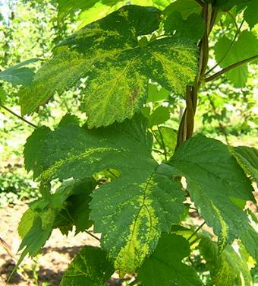
Introduction
Hop stunt viroid primarily affects aromatic varieties and causes:
Stunting
Leaf curling, & speckling on leaf veins
Reduced cone weight
HSVd Symptoms, Image: D. Gent, USDA-ARS.

Slide 5
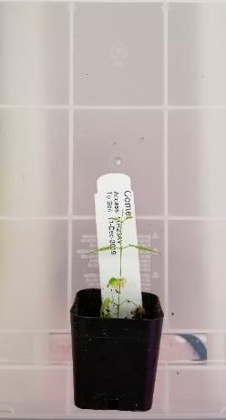
Introduction
Hop latent viroid is symptomless in most cultivars, but can cause:
Chlorosis of leaves
Fewer laterals and smaller cones
Reduced alpha-acid content

Slide 6
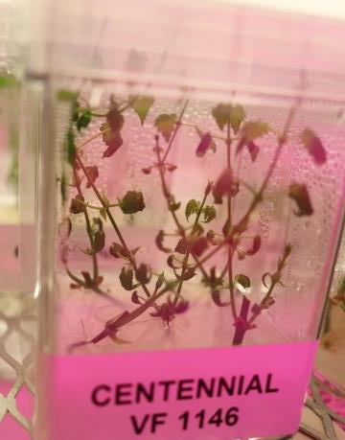
Introduction
Viroid (and virus) elimination techniques are based on:
Excision of (hopefully) uninfected tissue
Regeneration of new plants from this tissue.

Slide 7
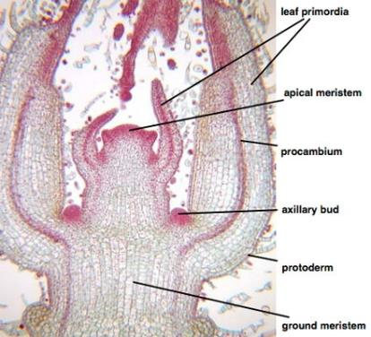
Introduction
Meristem excision alone has a high failure rate:
80% for HSVd infected plants
30% for HLVd infected plants

Slide 8
Introduction
Virus elimination is based on assumptions:
Which tissues to the target viruses/viroids infect?
How much tissue is needed to regenerate the plant successfully?
Can we expand the virus-free tissues by treatment?

Slide 9
Objectives
Objectives:
Identify the tissue distribution of HSVd and HLVd using in-situ hybridization.
Examine the effect of low temperature and low light on the titer and distribution of HSVd and HLVd in infected hop plants.

Slide 10
Results
Used a combination of:
In-situ hybridization to visualize where the viroids are located in hop plants
Real-time RT-qPCR to measure viroid titer in different tissues

Slide 11
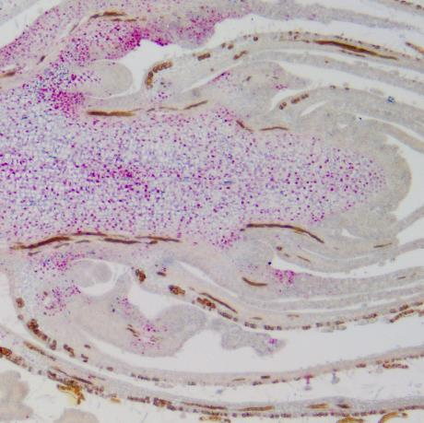
Results
HSVd:
Infects most cell and tissue types
Distributed evenly throughout the plant

Slide 12
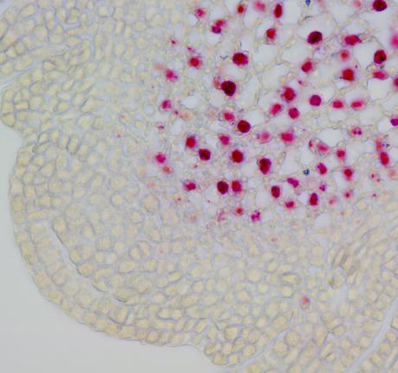
Results
HSVd:
Does not infect the meristem itself.
Present in the corpus cells just below the L1-L3 tunica.
0.1mm
0.0039 in

Slide 13
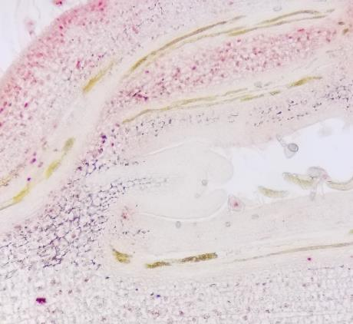
Results
HSVd:
Absent from adventitious buds.

Slide 14
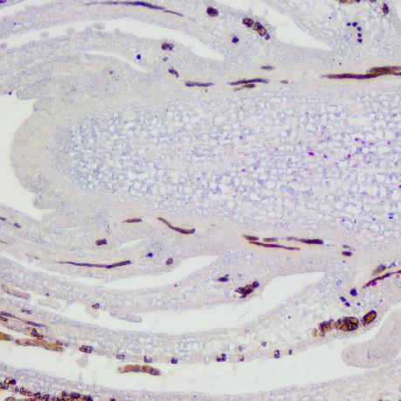
Results
HLVd:
Less cells infected around vascular tissues and near apical meristem
Absent from axiliary buds

Slide 15
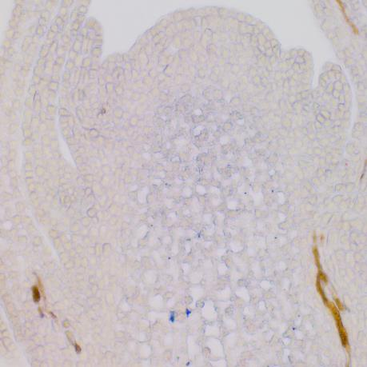
Results
HLVd:
Does not infect the meristem itself.
Absent from the corpus cells.

Slide 16
Results
Distribution summary
The proximity of the viroids to the meristem leaves a section of less than 0.1 mm for excision (for HSVd)
Unless we can halt viroid replication and make the plant grow away from them…

Slide 17
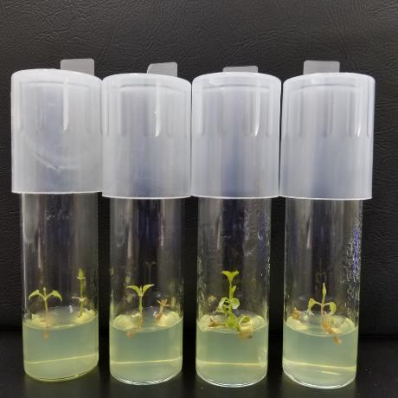
Results
Cold treatment
Low temperatures, like high temperatures, reduce the activity of enzymes needed for viral replication

Slide 18
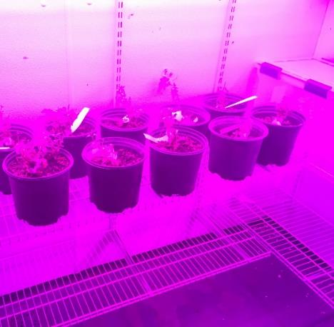
Alternative Methods for Viroid Elimination
3 months at 3 °C
Used both potted and smaller tissue cultured plants
Plant growth was significantly reduced

Slide 19
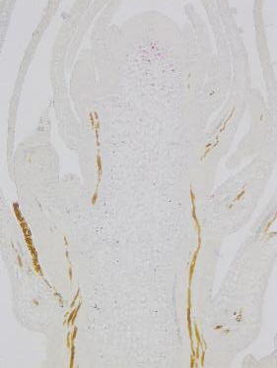
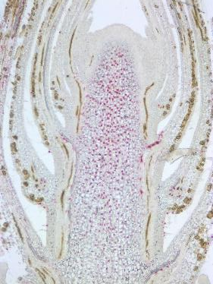
Results
HSVd after three months at 3 °C
Treated
Control

Slide 20
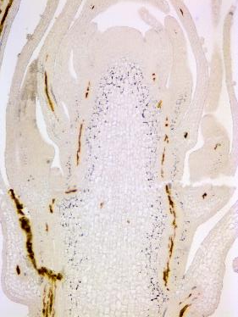
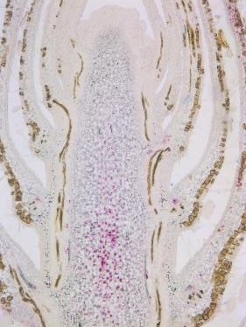
Results
HLVd after three months at 3 °C
Treated
Control

Slide 21
Results
Cold therapy summary
Viroid titer is significantly reduced, though HLVd is more significantly affected than HSVd
Distribution is unaffected for HSVd, HLVd change is likely due to the titer drop

Slide 22
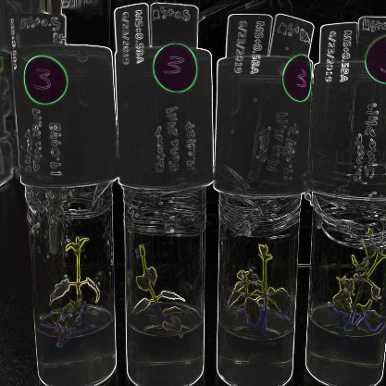
Results
Dark treatment
Low light can reduce plant growth, affecting viroid replication

Slide 23
Results
Dark treatment
In-vitro cultured plants
25 °C, constant darkness (controls at 70 µmol PAR)
2 months
Hormone-boosted media

Slide 24
Results
Dark treatment
Virus titer increased.
Hop cultivar-specific response observed.
Dark Treatment |  | Fold Change
 |  | HSVd | HLVd
1-month | Comet | 8.82** | 13.68**
 | Chinook | 6.90* | 8.10**
 | Canadian Red | N/A | 10.60**
 | Wuerttemberger | N/A | 16.17**
2-month | Comet | 17.73** | 14.58**
 | Chinook | 13.21** | 7.22**
 | Canadian Red | N/A | 9.87**

Slide 25
Conclusion
Summary:
Hop viroids, particularly HSVd, have a broad cellular distribution.
Cold treatment reduces titer but does not affect distribution.
Dark treatment is ineffective.

Slide 26
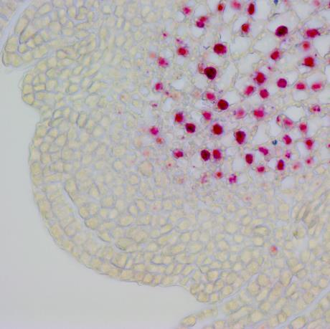
Conclusion
Summary:
Meristem excision remains the sole method for Hop viroid elimination.
Axiliary buds look promising.

Slide 27
Acknowledgements
Funding & Support:
Hop Research Council
Washington Hop Commission
National Clean Plant Network

